Slide 1
ADQ14-DC
Juliana Echternach and Ben Schneider

Slide 2
Contents
Overview of Device
Getting Started + Compiling
Debugging + Checking Code
Our Setup
Future Work

Slide 3
SLIDES LEFT TO DO
Hardware overview of the ADQ14-Dc
Internal Hardware (how chasis -> FPGA -> memory -> processor-> computer )
External Hardware (how to hook up IQ mixers)
How UserLogic2 Connects to the rest of the program
How the software communicates with the hardware
FIX ABBREVIATIONS

Slide 4
Overview of Device

Slide 5
About the ADQ14
14 bit samples
2 GSPS Digitizer
2Gbytes of memory
Can record multiple records without having to stream to host PC (time saver)
Supports various types of triggering
Continuous, Triggered, Level, Data Driven triggering, external triggering, software triggering, and internal triggering
Real time custom processing

Slide 6
Why use FPGA for calculations?
Advantages:
Hardware is significantly faster
Real time custom processing
FPGAs are reprogrammable and versatile
Can stream data to the PC and record multiple records with on-board 2Gbytes memory
ADQ14 uses software development kit to implement custom design and control the application
Disadvantages:
It’s less flexible than programming simple software
difficult to understand and debug, overall slower programming

Slide 7
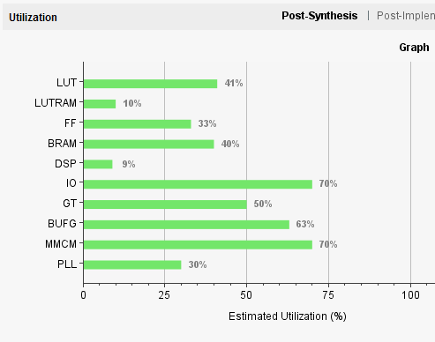
How Much of the FPGA Are We Using?
We have a lot more room for calculations!
LUT 41% -> can implement FFT
Majority of the utilization on board came with SP Devices Software Development kit
FILL IN THIS INFORMATION MORE THOROUGHLY
Summary report when compiling UL2. Can access everytime you compile under Reports, Logs, Messages tabs .

Slide 8
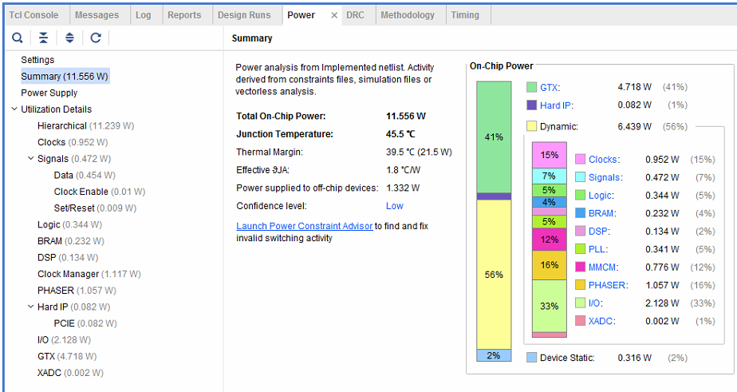
Power Usage
After compiling under ’Power’ tab you can see a summary of how much you are using and where your power usage is going

Slide 9
Geting Started + Compiling

Slide 10
Read the Manual and ReferenceGuide
Manual = Overall Setup
Helpful to understand the flow of data
How to set up the DevKit
ReferenceGuide = C Code documentation
Functions to use in Visual Studios
Useful controls
Use Software Development Kit (SDK) to program the FPGA and the c code to communicate with your program
C code allows you to read out data, save to text files, etc.

Slide 11
Software Development Kit (SDK)
UserLogic1 (UL1)
Advance Data Trigger
UserLogic2 (UL2)
Data processing logic
Most (all) of the work goes in this file
It is helpful to create modules that perform separate calculations that you can call in UL2
Create a testbench to extensively test modules before compiling the entire program (huge time saver)
Creating a testbench allows you to simulate module behavior, debug, and trace through your hardware
Test Bench was provided by SP Devices that is still accessible

Slide 12
How to Compile
Want to test Vivado Code
Tools -> Run Tcl Script -> Devkit.tcl
Command Prompt : devkit_synth_ul 2 // creating a netlist for UL2
devkit_synth_ul 1 // can skip if did not modify UL1
Click ’Generate Bitstream’
Wait ~30 mins
Done :
Command Prompt: devkit_mcs // generate ’.mcs’ file
Once ’.mcs’ is in logfiles = done compiling vivado

Slide 13
Uploading to ADQ14
Make sure USB Cable is connected to FPGA and Computer
Open ’ADQUpdaterGUI’
Refresh and connect to USB
Upload correct ’.mcs’
C:\Users\Speedy\Desktop\SP Devices\ADQ14__4C_DevKit_r31282\implementation\logfiles
*Erase and Update*
Execute (~10 mins)

Slide 14
Once Uploaded
Shut Down ->Turn off Digitizer -> Turn on Digitizer -> Turn on Computer
Open Visual Studios
’simple_streaming_acquisition’
*Local Windows Debugger*

Slide 15
Programming in Verilog

Slide 16
Preface
Verilog is not a difficult language, but it can be frustrating
It is very detail oriented
This is what is tricky-> you must know what you are doing every step of the way
This is not like software programming-> you will not get results without understanding what you are doing, what you expect as a result, where this could be going wrong, and how you know that your results are valid and stable
This is a hardware description language, you should be able to physically trace where the current is flowing in your program
I suggest you have a plan, how you want to test, and be able to trace your wire through every step of the program

Slide 17
Beginner Basics
Verilog is a hardware description language (HDL)
Not the same as software programming and languages, although very similar you must remind yourself that you are describing how to connect wires in a circuit, and that gives physical constraints
You can use both Combinational and Sequential logic to implement design
Combinational logic is logic that only depends on present inputs
ie. Addition, subtraction, logic statements, bit shifts
Sequential logic depends on past information and present inputs to produce output
ie. Accumulating and integrating
https://inst.eecs.berkeley.edu/~cs150/Documents/Nets.pdf

Slide 18
Assignments + Declarations
Declaring:
wire a; // represents a wire that carries one bit of information
reg b; // represents a single bit register
wire [3:0] b; // 4-bit wide wire declaration (can vary to however many bits)
To assign something to the opposite or ’not’ use ’ ~ ’
Changes a 0 -> 1 and 1->0
assign a = ~b;
Assigning numbers and exact values :
assign a = 1’b0; // wire a is set to binary 0
assign b = 4’d6; // 4 bit wide decimal number 6
Assigning using logic statements:
assign a = b & c; // logical AND
assign a = b | c; // logical OR
Clock Terms:
negative edge
’falling edge’
positive edge
’rising edge’

Slide 19
Reg vs. Wire
Assign reg to values that are changing and are often clock dependent
Registers are designed to hold a data value as output until they are told to change
this is why they are useful in sequential logic, they can hold or ”remember” values for as long as you tell them to
If you are using a loop, if statement, or handling any value that know you will change throughout the program, you will most likely use a register
Wires are fixed values, just like real wires, whatever you connect one end of the wire to or ’assign’ to is where it will stay
Assigning two values to a wire will result in error
Register will not change value until it reaches the positive edge of a clock
SIMPLE REGISTER:
reg[3:0] reg1; // 4 bit register
always @(posedge clk)
begin
if(reg1 == 4’d10)
reg1 <= 0;
else if (reg1<10)
reg1 <= reg1 + 1;
end
SIMPLE WIRE:
reg[3:0] wire1;
assign wire1 = 4’b0101;
Note the difference in assignments of reg vs. wire !!
assign wire = 1;
reg <= 1;
Register
If statements are like the ’select bits’ or enable statements. This the condition is true ==1 then the register will update according to that value.
Wire
IN
OUT
CLK

Slide 20
Logic Statements
Logic Gates are useful in controlling the data path
Can always check logic with Truth Tables (can search online for more examples)
General Convention - Active High: True = 1, False = 0
- Active Low: True = 0, False = 1
My code always assumes active high
Contruct Logic gates to have a signal be true or false depending on conditions
Logic design is controlling where current flows, so using controls allows you to trace back through you code
If an output is not what you expect you can trace back through you logic and check if certain control signals are working

Slide 21
Beginner Example Code
Useful file to get the hang of verilog programming

Slide 22
Practice
There is a practice project in the folder ’FPGA Juliana’ that you can use to experiment with Verilog
File comes with a ’ex_adder.v’ and a ’testbench.v’
The purpose of this project is to implement an adder that adds 4 input signals and outputs their sum, average, and also the AND and OR of all the bits.
The next few slides walk through the steps of how the files were implemented

Slide 23
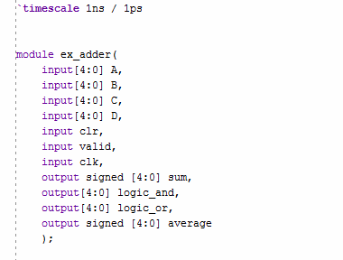
’adder.v’
Module name
You must always declare the module at the top of the file with the module name, inputs, and outputs
Generally it’s a good idea to keep the module name the same as the file name
’timescale 1ns/ 1ps gives a scale for the simulation (remember to have in every file as well)
indicate bitwidth
Control inputs usually 1 bit
Specify if the output is signed

Slide 24
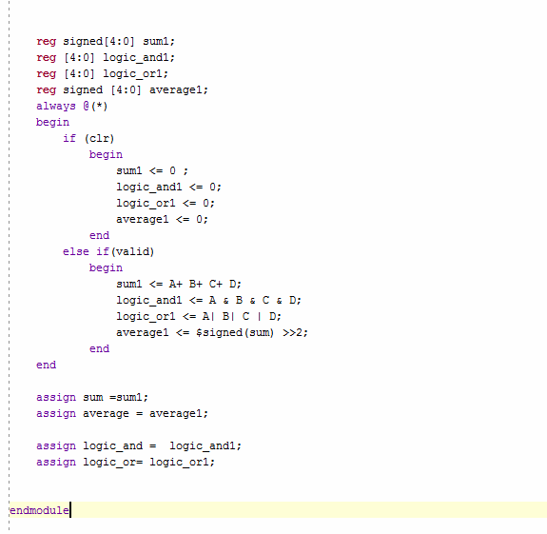
This implements a loop that is controlled by inputs
Always @(*) indicates that at all times, regardless of the clk edge, follow the instructions in the loop
This means that register values can change at any time, regardless of clock cycle
In UL2 we use ’always @(posedge clk)’ which means at every clock edge check the control inputs and follow the instructions in the loop.
This is useful because register values will not change until they meet a positive edge of the clock
Holding values to clock edges allows for synchronization in code, you can have various tasks throughtout the project but they are all tied to the same clock
this loop is very important to coding in verilog and frequently used in UL2
If performing multiple tasks under an ’if’ statement you must include a ’begin’ and ’end statement
-Right shifting >> x is a way of dividing by 2^x
-We will see in the testbench that right shifting a signed value does not work because the sign extension is dropped in the bit shift and replaced by 0s rather than 1s.
Don’t forget to ’endmodule’ at the end of the file!

Slide 25
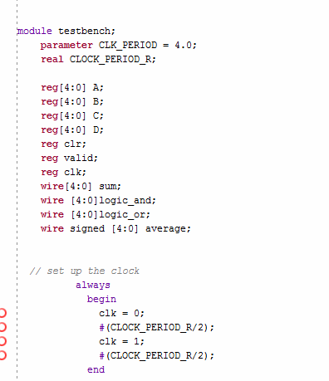
’testbench.v’
Declare all inputs as registers in the test bench and all outputs as wires
Make sure to set up the clock in the testbench (can always copy paste from this file)
INPUT
OUTPUT
Create periodicity of the clock with a period of 4ns
#() is used to indicate how many nanoseconds to pause
This sets the clk = 0, pauses for 2 seconds and then clk =1 and holds for 2 secs
real CLOCK_PERIOD_R is used for pausing and is set equal to the parameter CLK_PERIOD later in the code

Slide 26
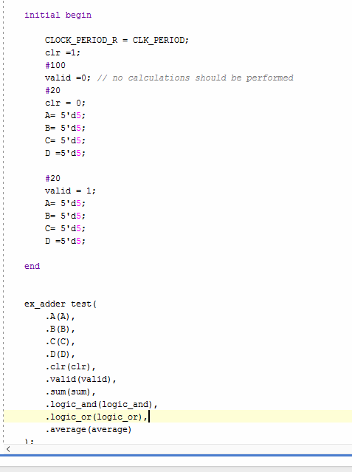
Testing
Initial begin indicates the start of the simulation
After this you begin pushing in your test values
# (pause for some nanoseconds)
Send in test values to the testbench
Declare the Unit Under Test at the end of the simulation (ex_adder) and declare what values you will feed to the inputs and outputs of the module
Make sure declarations match and you are pushing the right values to the correct spots
Don’t forget to end your simulation!
Unit Under Test

Slide 27
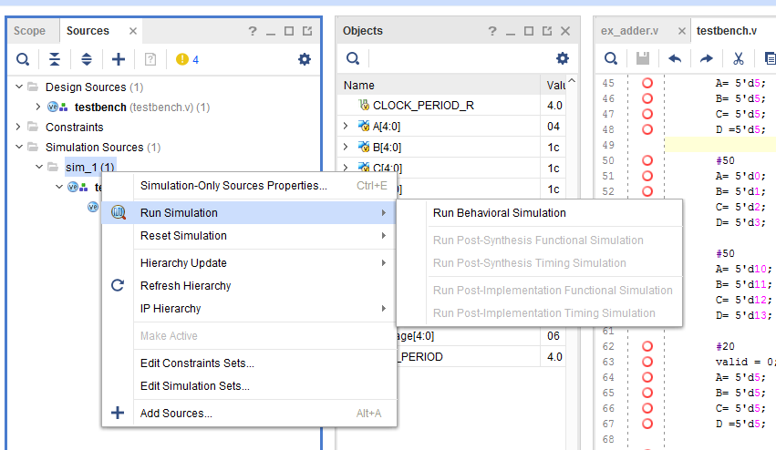
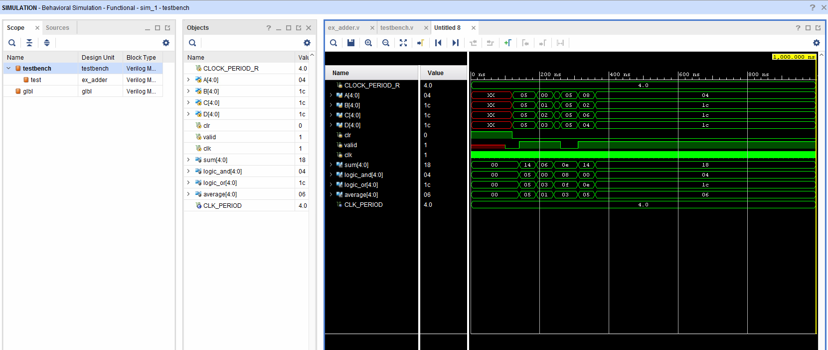
Test the code by running simulation! *Run Behavioral Simulation*
Real time simulation will appear and you can modify which signals you are looking at by dragging signals from ’Objects’ Column
Here you can see the scope of your design (testbench and the unit under test) and see the object that you can run under the simulation
You can change the format of your data to Signed Decimal, Hexadecimal, Binary, etc. by right clicking on a signal -> Radix –> *choose format*

Slide 28
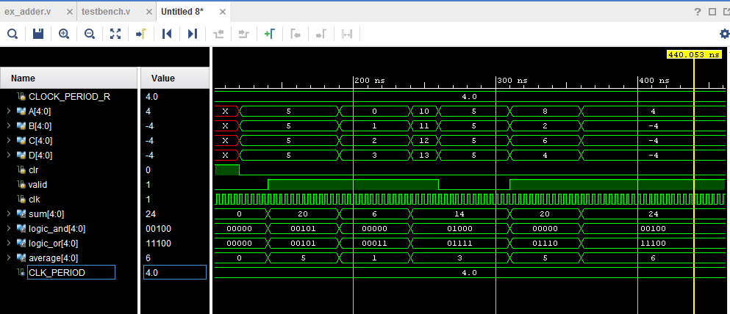
Use the control signals to determine if calculations are there
Red signal means that there is no signal running through this wire
Blue indicates that there are too many signals going into a wire (either you declare two different signals into the same wire or something is flowing in the wrong way)
Green means there is one signal reaching the wire (careful just because the signal is great does not mean that it is the correct value)
You can walk through the simulation and see when we are pushing in 5,5,5,5 the Sum outputs 20 and the average is 5. Logical And and Or are a bit harder to see but if you change the radix of input signals it will be easier to check
Observe that the output does not change until valid signal goes high
There is an error in the the last average! Remember this was predicted as we were bit shifting a signed number
>>> for signed shifting
>> for unsigned shifting

Slide 29
Debugging + Checking Code

Slide 30
Reading Out Values
Use Control Registers ! (see later slides)
By sticking in certain values into a 32 bit register you can read out the value in the C code when streaming
ReadUserRegister(userlogic, reg address);
ADQ_ReadUserRegister(adq_cu, adq_num, 2, 0x14, &read_0x14);

Slide 31
Check Calculations
Raw Data will be in textfiles ’waveform0_ch2.txt’
C:\Users\Speedy\Desktop\SP Devices\ADQ14__4C_DevKit_r31282\ul2_examples\simple_streaming_acqusition\simple_streaming_acquisition_software
Check work with Excel: ’FPGA_DataCheck’
Can copy and paste data from text file onto Cols. A B C D
Compare Raw data calculations on excel with what you read out on registers

Slide 32
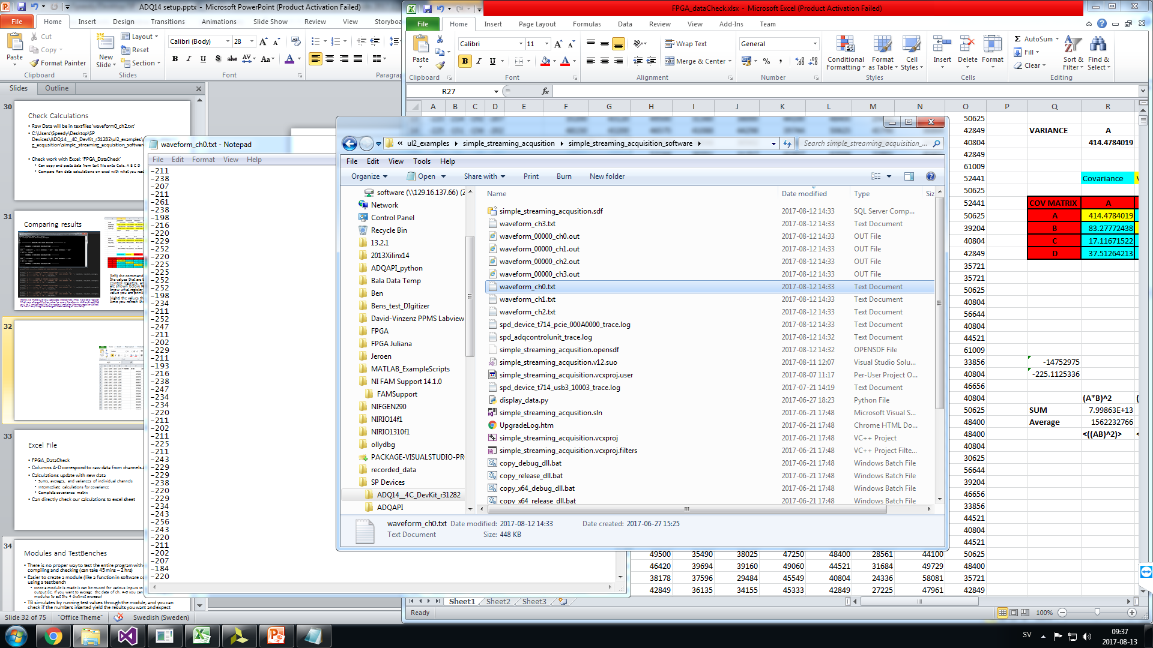
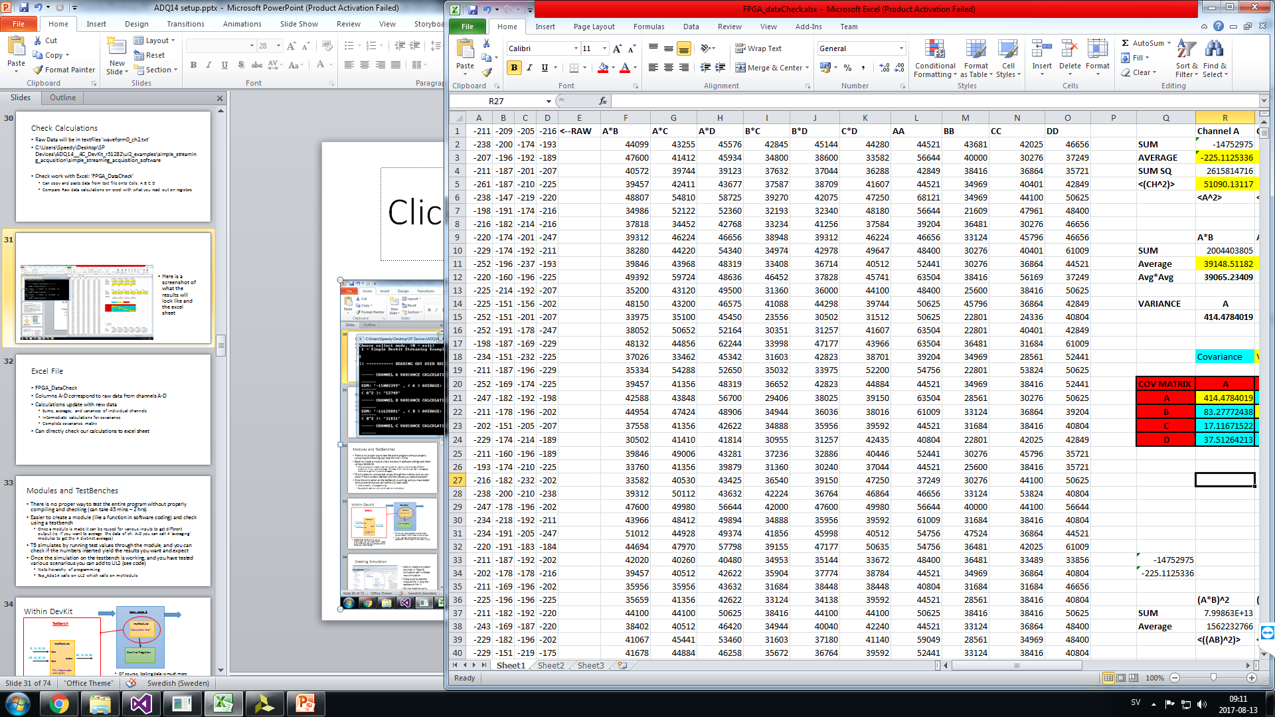
Copying to Excel
Here you can see the data path to the text files. Channel A data file is clicked on and opened in the back. The excel file shows where the corresponding text should be copied and pasted to

Slide 33
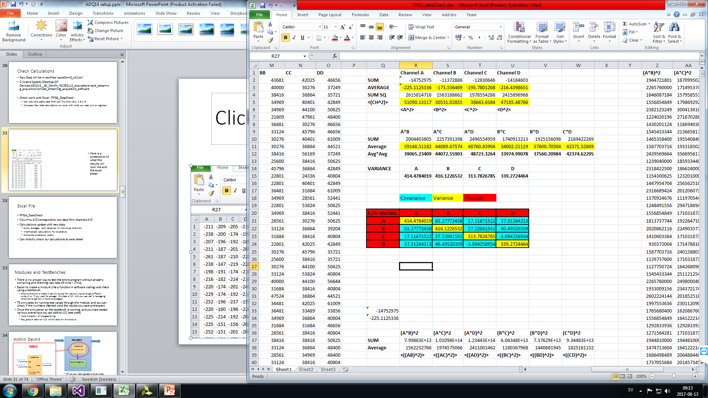
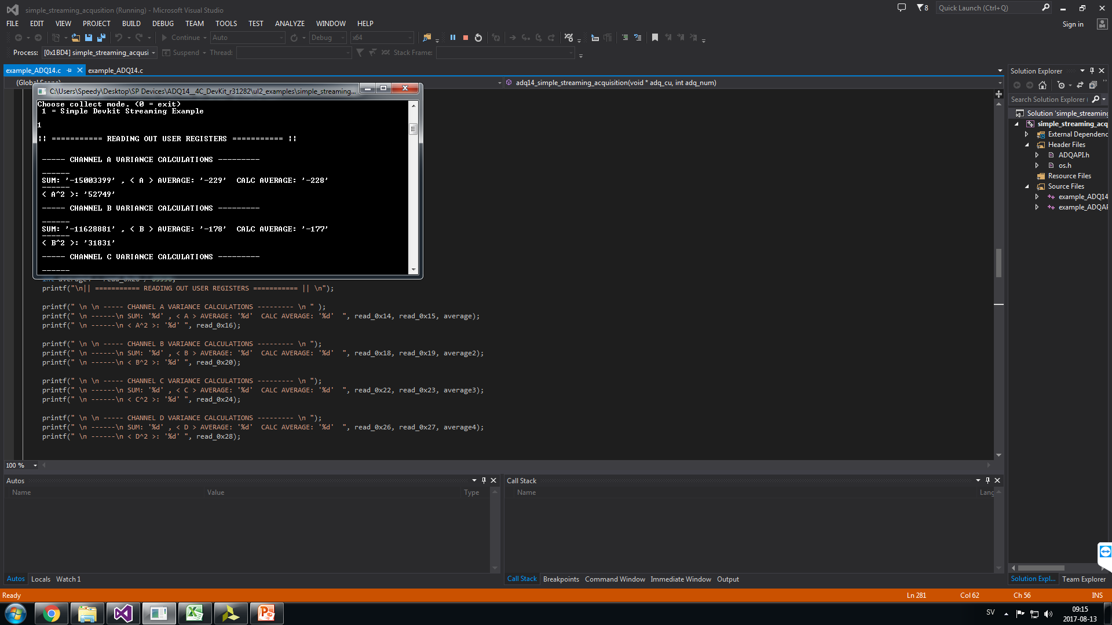
Comparing results
(left) the command screen that displays the values that are being read out from the control registers, and the print commands are shown below. Note: make sure you know what register correspond to what value you are printing.
(right) the values that will update each time you refresh the values on excel.
Note: to make sure you uploaded the correct ’.mcs’ have one register that you change the hex value for every iteration in UL2 and read that out in C and check that the readout matches the new register (difficult to tell if anything has changed from looking at raw data)

Slide 34
Excel File
FPGA_DataCheck
Columns A-D correspond to raw data from channels A-D
Calculations update with new data
Sums, averages, and variances of individual channels
Intermediate calculations for covariance
Complete covariance matrix
Can directly check our calculations to excel sheet

Slide 35
Modules and TestBenches
There is no proper way to test the entire program without properly compiling and checking (can take 45 mins – 2 hrs)
Easier to create a module (like a function in software coding) and check using a testbench
Once a module is made it can be reused for various inputs to get different output (ie. If you want to average the data of ch. A-D you can call 4 ’averaging’ modules to get the 4 distinct averages)
TB simulates by running test values through the module, and you can check if the numbers inserted yield the results you want and expect
Once the simulation on the testbench is working, and you have tested various scenarious you can add to UL2 (see code)
Note heirarchy of programming
Top_Adq14 calls on UL2 which calls on myModule

Slide 36
Within DevKit
User Logic 2
TestBench
myModule
*Caculations here*
myModule
{5, 10, 15, 20}
input
Control Registers
{30, 40, 50, 60}
{25, 30, 35, 40}
output
input
This Module adds two signals
Of course, testing data is much more complicated – but visual is nice to have
If you can get myModule to work in a testbench, more likely it will work in UL2
WARNING: TestBenches are as meaningful as you make them! Make sure what test values corresponds to what you want to test

Slide 37
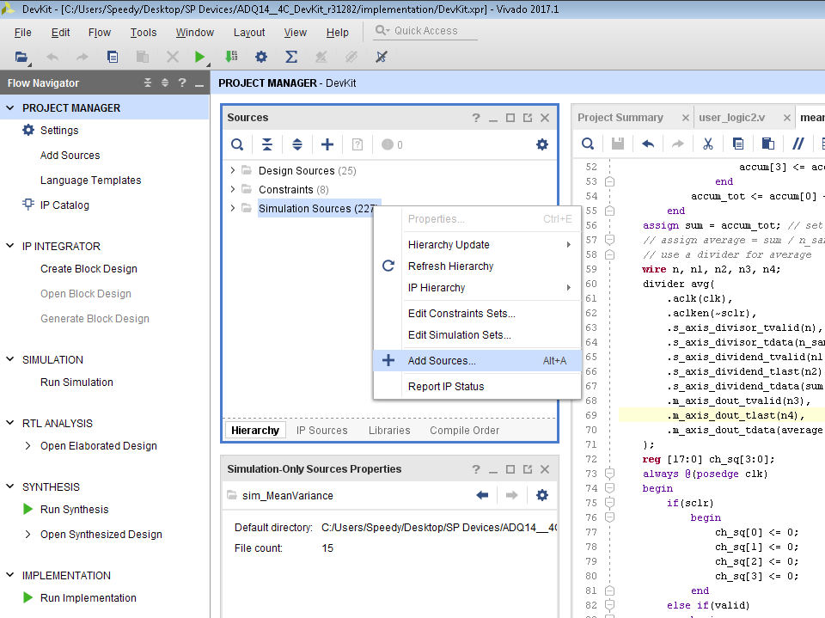
Creating Simulation
Add or create simulation sources -> *Specify simulation set*-> Create new simulation
Make sure to add the module file ’.v’ and the testbench file ’.v’
Do not need to worry about inputs and outputs
Follow previous ex.

Slide 38
Design not working?
Do bit widths match?
ex. if you declare a wire to be 32 bits and assign it to a module input that takes in a different amount, there will be errors either no signal will get through or data will be parsed
Is your data signed or unsigned? Do the calculations follow your intended sign convention?
Timing: Is your data arriving too early or too late? Check triggering and control logic
Are you reading out meanful data?

Slide 39
Our Setup

Slide 40
Basic Operation
The Software Development Kit allows you to communicate your custom logic with the Digitizer
The ADQ14 Dev Kit Folder contains a lot of files (reading manuals about these files will help) but there are a few files that you must worry about
UserLogic1 and UserLogic2 are the portions that can be customized for hardware logic
Simple_acquisition_streaming is the c-file that can communicate the FGPA with the computer and digitizer
This summer we focused on averaging signals and acquiring a covariance matrix of all 4 channels
We will implement our design ideas through UserLogic2

Slide 41
Our Plan
Create a covariance matrix from the 4 incoming signals
Channel A: I1
Channel B: Q1
Channel C: I2
Channel D: Q2
Each calculated value is pushed into a Control Register
Check work through Control Register
Start with single channels: calculate sum, average, square, sum of squares, and average square (meanvariance.v)
Calculations with two signals (sig2corr.v)
Stick calculations in covariance calculator (covariance.v) and repeat across all 4 channels and combinations until we have a complete variance- covariance matrix

Slide 42
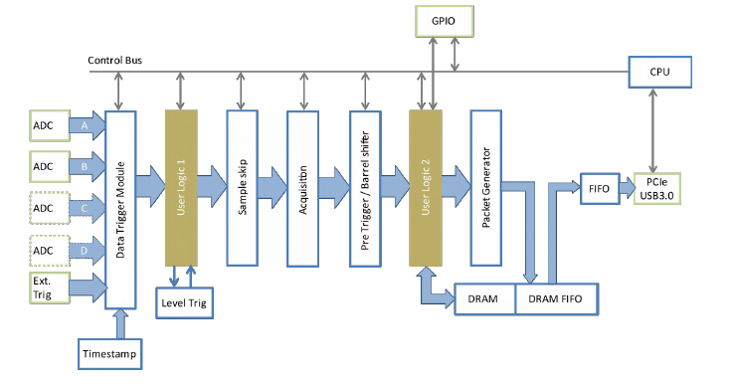
Data Flow Chart
Fir

Slide 43
clk
User Logic 2
Control Register
Valid Logic
trigger
Sig2Corrr
clk
Data
valid
sclr
valid
[35:0] sum
[63:0] data1
[31:0] average
[35:0] sq_sum
[63:0] data2
[31:0] avgsqsum
covariance
clk
sclr
valid
[31:0] covarianceXY
meanvariance
[31:0] avg_XY
[31:0] varianceX
[35:0] sum
[31:0] avgX
[31:0] varianceY
clk
[31:0] avgY
sclr
[31:0] average
[31:0] avgX2
valid
[35:0] sum_square
[31:0] avgY2
[63:0] data
[31:0] avgvar
Data Bus In
Data Bus Out

Slide 44
Covariance Matrix
Variance between two signals (A,B): <(AB)> - <A>^2<B>^2
Covariance: E(XY) – E(X)E(Y)
 | Ch.A I₁ | Ch.B Q₁ | Ch.C I₂ | Ch.D Q₂
Ch.A I₁ | <I₁I₁> | <I₁ Q₁> | <I₁I₂> | <I₁ Q₂>
Ch.B Q₁ | <I₁ Q₁> | <Q₁ Q₁> | <I₂ I₂> | <Q₁ Q₂>
Ch.C I₂ | <I₁ I₂> | <I₂ Q₁> | <I₂ I₂> | <I₂ Q₂>
Ch.D Q₂ | <I₁ Q₂> | <Q₂ Q₁> | <Q₂ I₂> | <Q₂ Q₂>

Slide 45
Further Calculations …
Single-mode squeezing
σ₁ = (< I² > - < Q² >) / (< I² > + < Q² >)
Average Power
P_{avg} = (1/2)(< I₁² > + < I₂² > + < Q₁² > + < Q₂² > )
Two-mode squeezing
σ₂ = (< I₁I₂> - < Q₁Q₂> ) / P_{avg}
Should be easy to calculate once each component is calculated

Slide 46
Current Structure
Data Bus In
Data Bus Out
UserLogic2
Trigger Data +
Process Data
-single data points for covariance matrix
ReadUserRegister()
-read out data points on C code
Control Registers
Raw Data streaming in the macros of UL2 is collected and is the same data that exiting in the Data Bus. For now we are not inserting anything of our own into the data bus, but are reading out single calculated values from the Control Registers using ReadUserRegister() in Visual Studios. Enough data can be collected to have a complete covariance matrix.
Future work will be handling the covariance matrix and FFT in UL2 and streaming it in the Out Data Bus.
Calculating on Trigger is also essentially to ensure averaging and integration is performed accurately

Slide 47
What I think we can Implement in the Future
Data Bus In
Data Bus Out
UserLogic2
Trigger Data +
Process Data
-single data points for covariance matrix
FIFO
Transform Data: can store in FiFO and stream in data bus once raw data is out.
FFT + Correlation Measurement
ReadUserRegister()
-read out data points on C code
Control Registers
Feedback Logic

Slide 48
UserLogic2 Basic Structure
Userlogic2 is where you can put your customized logic
It handles the data macros that come in through the Data Bus and pushes the same data out to the data bus
You can modify what comes out of the data bus (see next slide for more details )
It comes with a regfile which serves as the control registers of the program
The control registers are what you can use to communicate with you FPGA program from the C Code
By setting registers equal to certain data values you can then read these values you through ReadUserRegister();
Userlogic2 is also where we call our calculation modules, and the easiest way to check our single value calculations is setting them equal to a register (see next next slide)

Slide 49
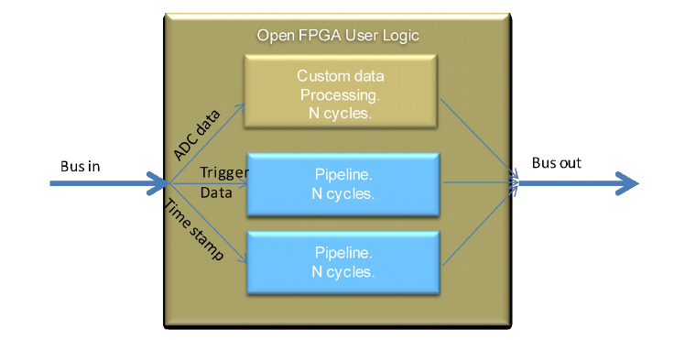
Data Bus Stream

Slide 50
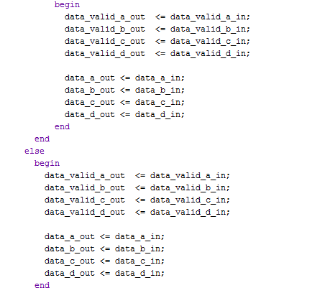
Data Bus
The Data Bus is structured as 4 channels, so you are constrained to seeing streamed output to these 4 channels
The only way to directly stream what is coming out of UL2 is to modify what is wired to the output
This makes observing more than 4 streams a little more difficult, and you would have to time your data accordingly
We keep it so that the A,B,C,D are what come in and out of the data bus, so that you can check your calculations with raw data
When checking your work it is often worth it to set a certain value to one of the 4 output channels
For example, to check whether the ’valid_counter’ was counting correctly, I set the counter = data_chD_out because we were not using Ch. D and we wanted to compare with raw data of Ch. A
** this is where you modify what goes in an out of the Data bus
**

Slide 51
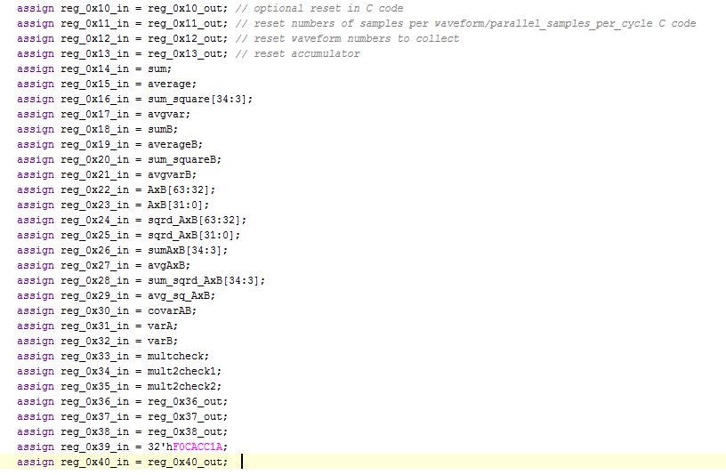
Control Registers in Vivado
You cannot modify first four registers(0x10-0x13)
In UL2 you can set the outputs to your modules equal to a register that is in the regile
Careful that the data you are sticking into your register file is 32 bits or less
if it is not then you should modify how many bits you are looking at or split the first 32 bits in one register and the second 32 bits in another
The register file I have modified to include 40 different 32 bit registers
Modifying a register to a different hexadecimal value each time you compile is helpful because then you can confirm that your compilation was sucessful (see reg_0x38_in)
Note: these are wires going into a register files, which is why they are assigned as wires
-A snapshot of how I tested various data values by sticking them in a register and reading it out later
-I would set a lot of intermediate calculations equal to the register so that I could trace back errors and see at what step did my calculations fail

Slide 52
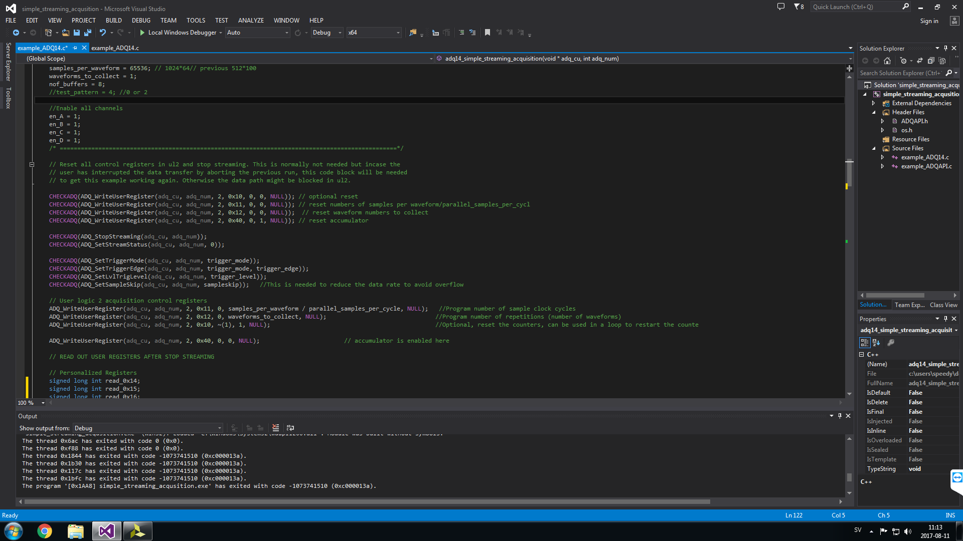
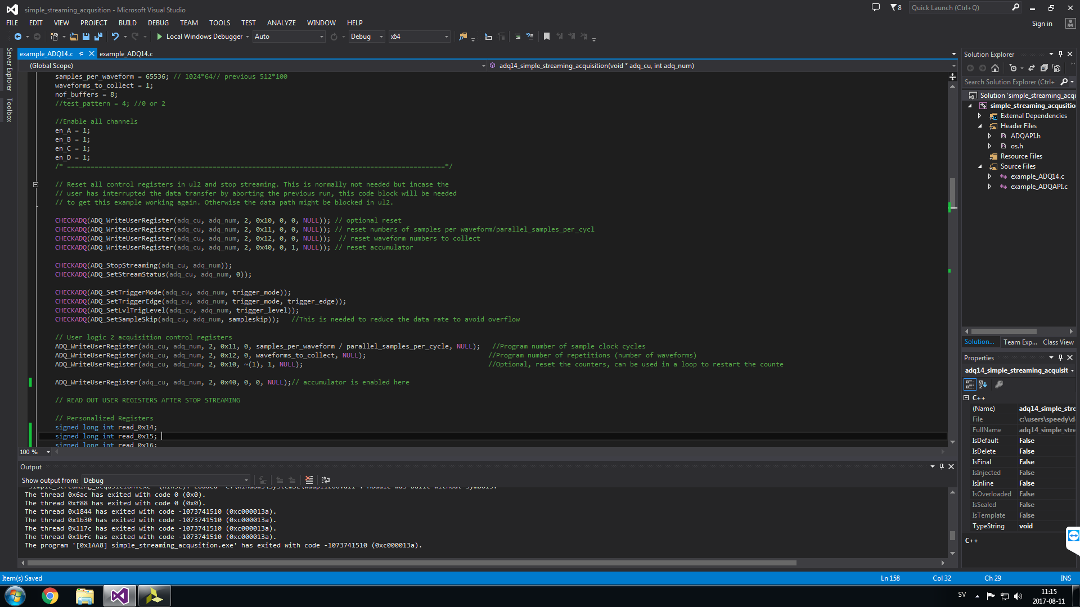
Control Registers in Visual Studios
Here is the setup for writing to the registers.
(above) Following Register 40 you can see that at first in the CHECKADQ() is a default setting the data is set to 1, which is the reset value for the valid signal in Vivado
(below) Once the Digitizer is turned on we write again to the register, this time a ’0’ to turn of the clear and allow measuring

Slide 53
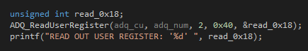
Writing and Reading Registers in C Code
WriteUserRegister( ul_target, regnum, mask, data, *retval );
- ul_target : 1 or 2 (writing to userlogic 1 or 2)
- regnum : register number (0x10 to 0x40)
- mask : this performs a negative mask (the bits that are 0 here are the bits that will be written to the register)
- data : unsigned int data to write (will be masked by ’mask’ value)
- *retval : is a pointer to where the read result will be saved (NULL)
ReadUserRegister(ul_target, regnum, *retval );
- *retval : is a pointer to where the read result will be saved
- This is the unsigned int variable that you declare
Here you can see the steps to reading out the values in the control registers.
- ’&read_0x18’ designates a pointer to the address of register 18
To read out the data in decimal format you use ’%d’
To read out in hexadecimal you can use ’%x’
Most of the control registers you will read out from will be in UserLogic2

Slide 54
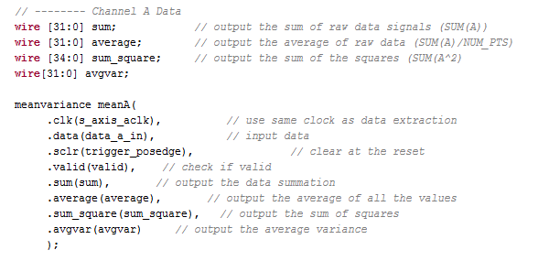
Using Modules in UserLogic2
1.) create wires for the outputs of the module
2.) Call on the module:
ModuleName individualModuleName(
.wireToConnect(actualWire));
-> individual module names must be different for every different module you call!
-> Make sure the wire to connect and the wire from UL2 have matching BitWidths!
3.) Connect output wires from module to either an input of another module or to a control register (to read out value in Visual Studios)
Here is an example of calling the meanvariance module in UL2

Slide 55
Handling Data
Data is streaming in and out of UL2 through the Data Bus Macros
New data comes in every clock cycle
4 Channels, 4 Parallel Samples per channel
Enter the Data Bus in 64 bit streams
data_chA [15:0] is sample N
data_chA [31:16] is sample N+1
data_chA [47:32] is sample N+2
data_chA [63:48] is sample N+3
Splitting up data helps with timing constraint, pipelining the data helps to keep constraint and organize information

Slide 56
Implementing the Design
Once we have a working module that produce output that matches the calculated from the excel sheets, we can use this module for every data channel
Our meanvariance module can be used to produce and average and variance for each of the 4 channels
Sig2Corr takes in two separate channels and finds components that relate to finding covariance. With this you can find the covariance of every channel combination by reusing the module with separate inputs and outputs
Covariance takes outputs from meanvariance and covariance to create covariance between two signals and the corresponding variances or the individual signals

Slide 57
Control Inputs
These are inputs to the modules that allow you control when they start their calculations and how long it takes.
Clock (clk) – synchronizes clk UL2 clock implementation so that calculations are timed with incoming data
Sclr – ’set clear’ determines when to clear the module calculations so that you are not calculating on old data
Valid – signal that says that calculations are okay to begin, the data is ’valid’ and triggered properly
This has been the biggest issue for us determining when to start calculating
Data arrives every clock cycle, so triggering must be precise for calculations to be accurate

Slide 58
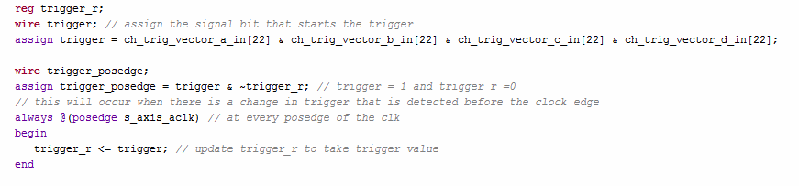
Data Triggering
We trigger out data by utilizing the trigger vector and finding the positive edge of when the data is triggered (loop below)
Data triggering is controlled by ch_trig_vector_in bit 22 -> when that occurs the data is triggered
We want to trigger the data as quickly as possible, so the positive edge when it first begins
Assign as a register because the value will change
To begin triggering you want all 4 data channels to be triggered (at least in our case), if you want to modify later you can

Slide 59
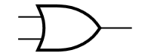
Valid
What determines if the incoming data the data that we want to calculate?
We want it to be the data that follows directly after the ADQ14 is triggered to start collecting data
We are taking 65536 samples. My idea was to have a counter that tracks for how many points the data should be valid
From the start of the positive edge of the trigger, the valid counter will be activated
As long as the valid counter > 0 then the data will remain valid
Logic statement to control what is valid
We see that in order for valid to be true (valid =1) then you have to have either the trigger_posedge =1 OR valid_counter >0 AND data_valid_a_in = 1.
If these conditions are not met valid =0 and calculations do not begin
trigger_posedge
valid_counter >0
OR
data_valid_a_in
AND
valid

Slide 60
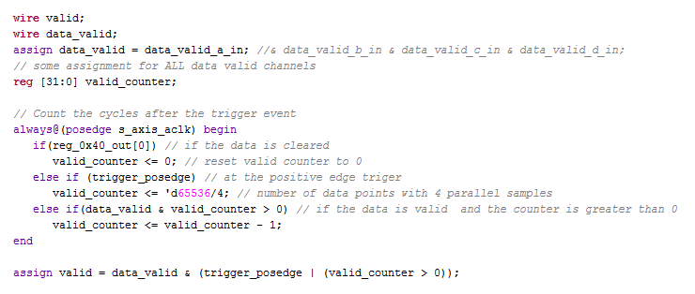
Valid Loop
Here you can see that the data is only valid for as many data points as you are testing
Observe that the counter is cleared when the 0 bit of ’reg_0x40_out = 1’, which is controlled by the c code
We are testing 65536 data points because it is an easy bit shift for division ’>>>’ and is divisible by 1024, which is how data is packaged
By maintaining this loop we ensure that we are measuring the exact amount of data bits we want

Slide 61
Set Clear – ’sclr’
We decided to make the ’sclr’ control input dependent on the triggering of the data, that way the data is cleared right when the trigger has started
Calculation begin right after the data is cleared as ’valid’ is dependent on the trigger_posedge
One solution is also to set a bit in a Register as the ’sclr’ bit then WriteUserRegister(); in the C code setting the register to 1 to clear data then 0 to enable the data
This idea works and is implemented in the valid loop to clear the valid counter when the reg_0x40_out = 1, which is coded in Visual Studios

Slide 62
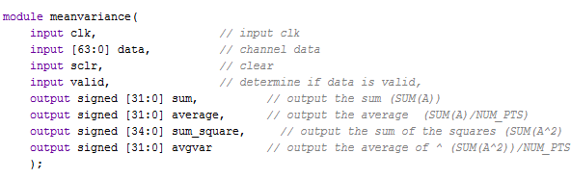
MeanVariance.v Design
Here we create a module where we can implement calculations for finding the sum, squares and respective averages of a single channel
Notes:
I am not sure if these slides are necessary→ just shows raw header of code

Slide 63
MeanVariance
Clears calculation and sets all values to 0.
Takes reset from UL2
Takes in valid, clear, clk, and one 64bit data channel
meanvariance
clk
[63:0] sum
∑(A)
sclr
[63:0] average
<(A)>
Only begins calculating once the trigger has begun and the data is ’valid’
valid
[63:0] sum_square
∑(A²)
[63:0] data
[63:0] avgvar
<(A²)>
-Because data arrives as 64 bit packages much of the arithmetic involves running 4 parallel calculations so that we can meet the time contraint of handling new data every clock cycle
-4 smaller calculations are much easier to accomplish than one large calculation (principle of pipelining)

Slide 64
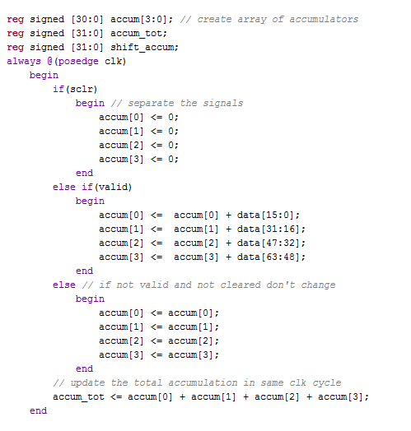
Accumulating Data
Creates a 4 bit array of 31 bit accum registers
(just another way of quickly declaring registers )
Summation Block in meanvariance.v
This is the standard way that we accumulate or sum up our data
This template is repeated multiple times throughout
*Note: 31 bits are assigned to accumulation while data bits are only 16 bits, this is to ensure that there is not an overflow in bits are we are adding a lot of samples you need to compensate bit width to hold a larger amount of data
**Note: the registers are declared as signed
Add raw data to the accum register
accum_tot is later set to the signed output ’sum’

Slide 65
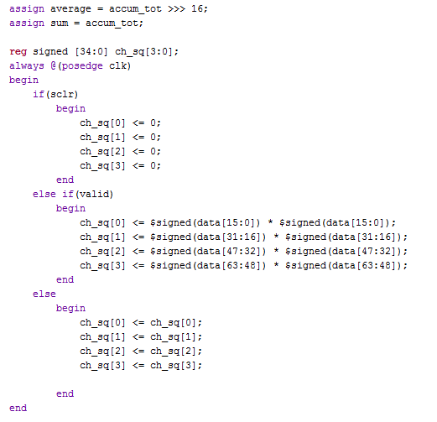
Averaging and Squaring
Division is accomplished by bit-shifting to get the average
Here we are dividing by 2^16 = 65536 which is how many sample points we are taking
Squaring the data is very similar to accumulating
signify that the registers are signed and multiplication is signed
Note the ch_sq reg array is 35 bits to compensate for large numbers

Slide 66
Sig 2 Corr Design
Takes in 2 channels of data along with other parameters
Outputs the sum of the multiplied signals and the sum of the square of the multiplied signals with respective averages
Sig2Corrr
clk
sclr
[63:0] sum
∑(AB)
valid
[63:0] average
<(AB)>
[63:0] data1
[63:0] sq_sum
∑(AB)²
[63:0] data2
[63:0] avgsqsum
<(AB)²>

Slide 67
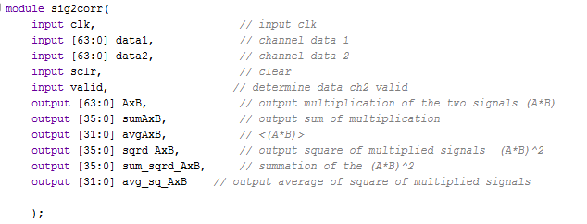
Sig 2 Corr
Not sure why I gave this name
This module takes two signals and performs various calculations that can be done between them
You do not need calculations of <(XY)^2> in covariance but what included to varify calculations

Slide 68
covariance
This takes in the outputs from meanvariance and sig2corr to calculate the covariance
Future Plans: I hope to include first order squeezing and have plans for finding the average power of the stream
covariance
clk
sclr
valid
[31:0] covarianceXY
<(XY)> - <X><Y>
[31:0] avg_XY
[31:0] varianceX
<(X^2)> - <X>^2
[31:0] avgX
[31:0] avgY
[31:0] varianceY
<(Y^2)> - <Y>^2
[31:0] avgX2
[31:0] avgY2

Slide 69
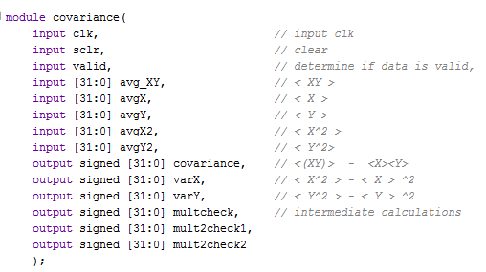
Covariance
This module handled the output from the intermediate calculations in ’meanvariance’ and ’sig2corr’ and uses this to get the covariance of the two signals and variance of the individual signals
Outputting ’multcheck’s are intermediate steps I output to check every step of calculations, so it does not need to be outputed but it is useful in debugging

Slide 70
What is left
Divide accurately without using the divide module (would take less space)
IMPROVE ACCURACY OF MATH
Read out data easier (Easy User Interface GUI)

Slide 71
WARNING ON MODIFYING CODE
If you want to modify the number of samples you are taking, consider all of the locations in the code that take into account sampling of ’65536’ samples!
Okay to modify but your code will have errors if you do not go back and change this
if you do change to change to a value that is logarithmic with 2 to make handling data easier
There are multiple locations throughout the code that can be indicated in the comments and in coming slides

Slide 72
C Code Devkit
Data is grouped by 1024 bytes
Samples are modulo 1024 each 2 bytes (size of a short)
Samples_per_waveform = 65536 (was originally 51200)
4 parallel samples
65536/4 samples per clk cycle
Waveforms to collect =1
Can modify any of these settings as see fit – just make sure the collection and process timing matches
Read Reference Guide for documentation of useful c-code functions

Slide 73
Tips to Designing
Draw your design
Think about how your module interacts with the rest of the program (ie. timing)
NEVER use combinational feeback loop
Glitches will occur and calculations incorrect
Must at least wait for a ’posedge clk’
Indicate if signal is signed (assumed unsigned if not)’SIGNED’ for ex:
Declare reg and wires as signed – reg signed
C = $signed(A) + $signed(B)

Slide 74
Notes
Triggering the data and the calculations is very important
Easy to think that you are getting all of the data, but a new set of data is coming in every clk cycle and it is easy to make a mistake
PIPELINE when at all possible
Increase throughput of calculations
Make sure that you are collecting at the points you want to collect, triggering is precise

Slide 75
Future Work

Slide 76
Future Work
Get a Complete Covariance Matrix
extensive testing
FFT Implementation
Send Signals Back to Sample (signal generation and logic)
Utilize FIFO to store more data if necessary (will be if eventually use FFT or send signals)

Slide 77
FIFO Module Created
I created and have tested a fifo that I have not been able to put into use
Standard fifo: takes in 64 bit data and pushes / pops from the stack
Can use to save data calculations to memory while data is streaming on the bus
Once raw data is done streaming can pop the calculations or SP data

Slide 78
FIFO module
module myfifo( clk, rst, buf_in, buf_out, wr_en, rd_en, buf_empty, buf_full, fifo_counter );
input rst; // reset
input clk; // clock
input wr_en; // write enable
input rd_en; // read enable
input [63:0] buf_in; // data input to be pushed to buffer
output[63:0] buf_out; // port to output the data using pop.
output buf_empty; // buffer empty
output buf_full; // buffer full
output[`BUF_WIDTH :0] fifo_counter; // number of data pushed in to buffer

Slide 79
FIFO
This is visible if you look at the code, but it is always nice to have a visual. FIFO is the First In First Out memory storage, so that the first data that is pushed in is the first to come out. This is a very useful feature for storing data streams.
rst
buf_empty
clk
buf_full
wr_en
[`BUF_WIDTH :0] fifo_counter
rd_en
[63:0] buf_in
[63:0] buf_out
wr_en =1
wr_en =1
wr_en =1
buf_in = 25
buf_in = 5
buf_in = 10
5 | 25
25
rd_en =1
rd_en =1
rd_en =1
buf_out = 25
buf_out = 5
buf_out = 10
10 | 5 | 25
10 | 5
10

Slide 80

Using IP Core for FFT
Uses low power, fast, reliable
Easier to both implement and test
LUT memory
https://www.xilinx.com/publications/prod_mktg/vivado/Vivado_9_Reasons_Backgrounder.pdf

Slide 81
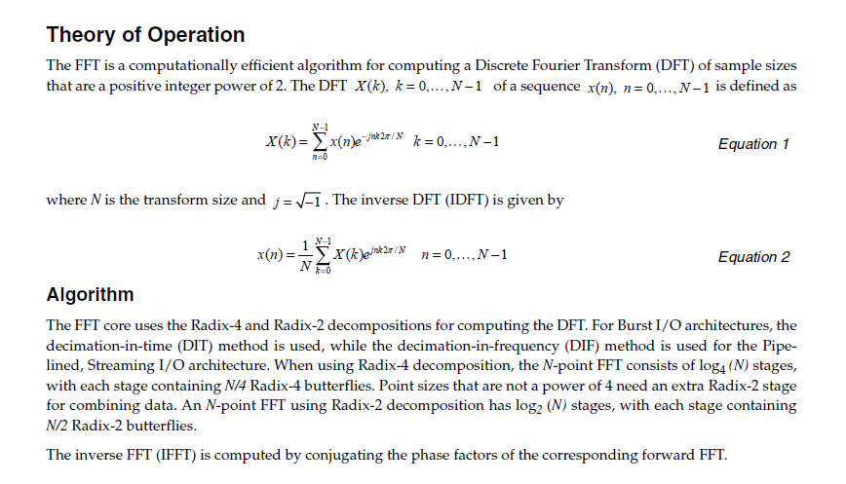
FFT IP Core
https://www.xilinx.com/support/documentation/ip_documentation/xfft_ds260.pdf

